Slide 1


Laravel

Slide 2

Laravel 01 Bina Projek Laravel Pemula

Slide 3
Module Outcome
Day 1
Create Laravel Project
Working with Database.
Working with Model
Working with Controllers
Working with Views
What will be needed
Laragon
phpMyAdmin
VS Code

Slide 4
routes/web.php
app/Http/Controllers
app/
resources/views
Notes:
In Slide Show mode, select the arrows to visit links.

Slide 5
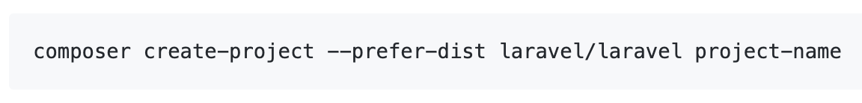
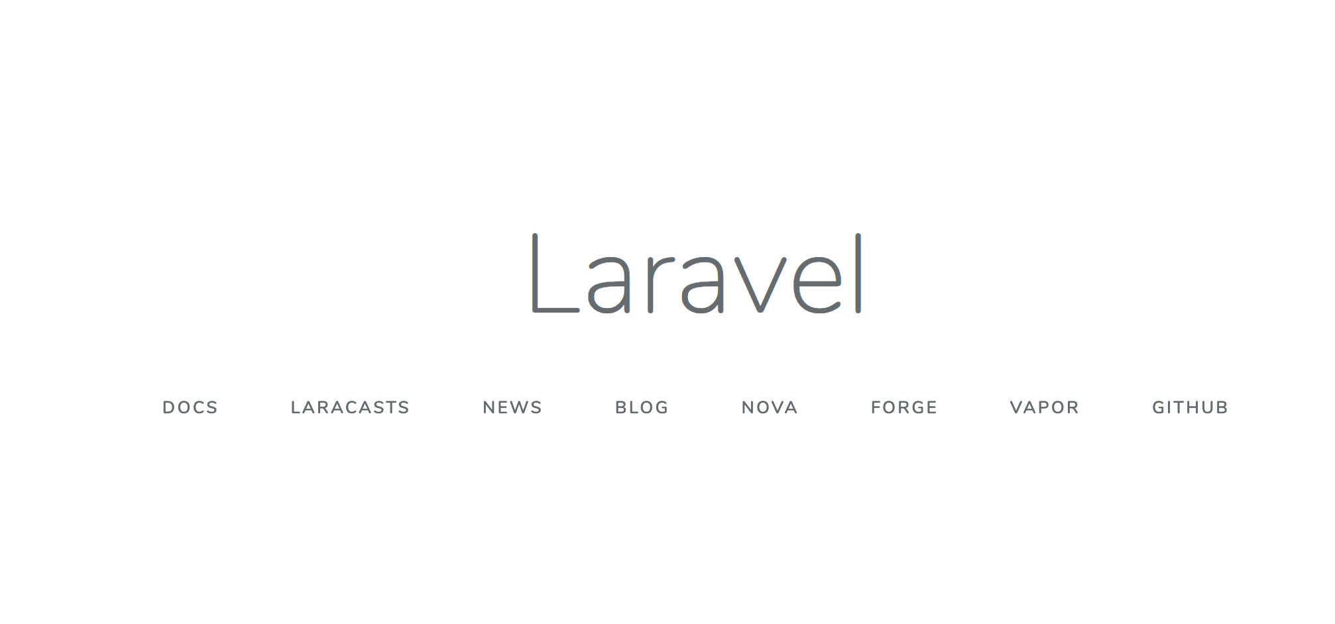
Create Laravel First Project
Install Laravel by issuing the Composer create-project command in your terminal

Slide 6
laragon.org
With Laragon?
Never been EASIER.

Slide 7
Laragon
What is Laragon? Laragon is a portable, isolated, fast & powerful universal development environment for PHP, Node.js, Python, Java, Go, Ruby. It is fast, lightweight, easy-to-use and easy-to-extend. Why Laragon? Laragon is great for building and managing modern web applications. It is focused on performance - designed around stability, simplicity, flexibility and freedom. Laragon improves web development. Developers all over the world are using Laragon to make apps quickly and easily. It is used by thousands of developers with loves. You can check out the Testimonials to see how users think of Laragon and it’s features page for more details.

Slide 8
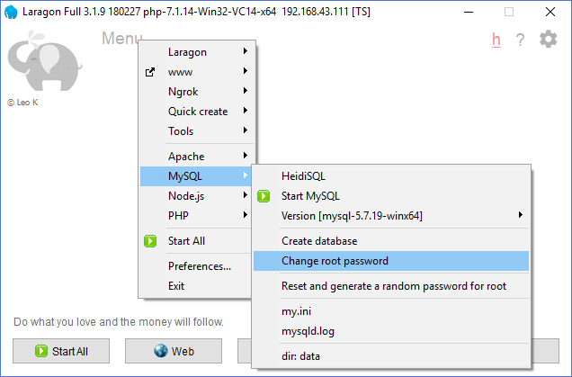
Change DB root password

Slide 9
Laravel t02 Cara mudah tambah laman login & daftar pengguna

Slide 10
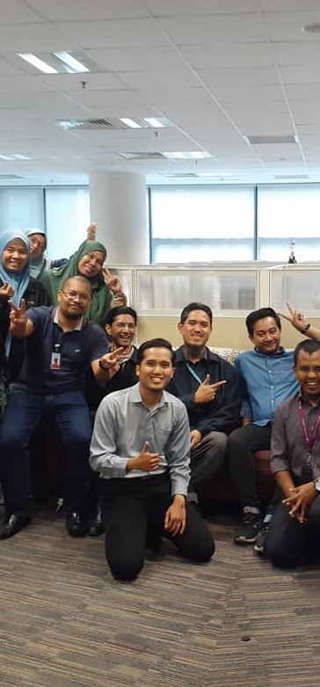
Laravel t02 Tambah laman login & daftar pengguna
fstm.kuis.edu.my/blog/laravel

Slide 11
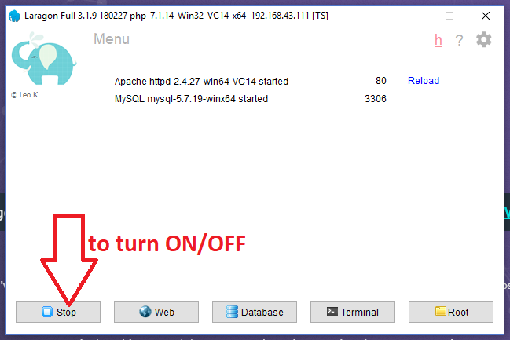
Turn On Laragon
By default Laragon will served port 80 for Apache and port 3306 for DB

Slide 12
Create Project

Slide 13
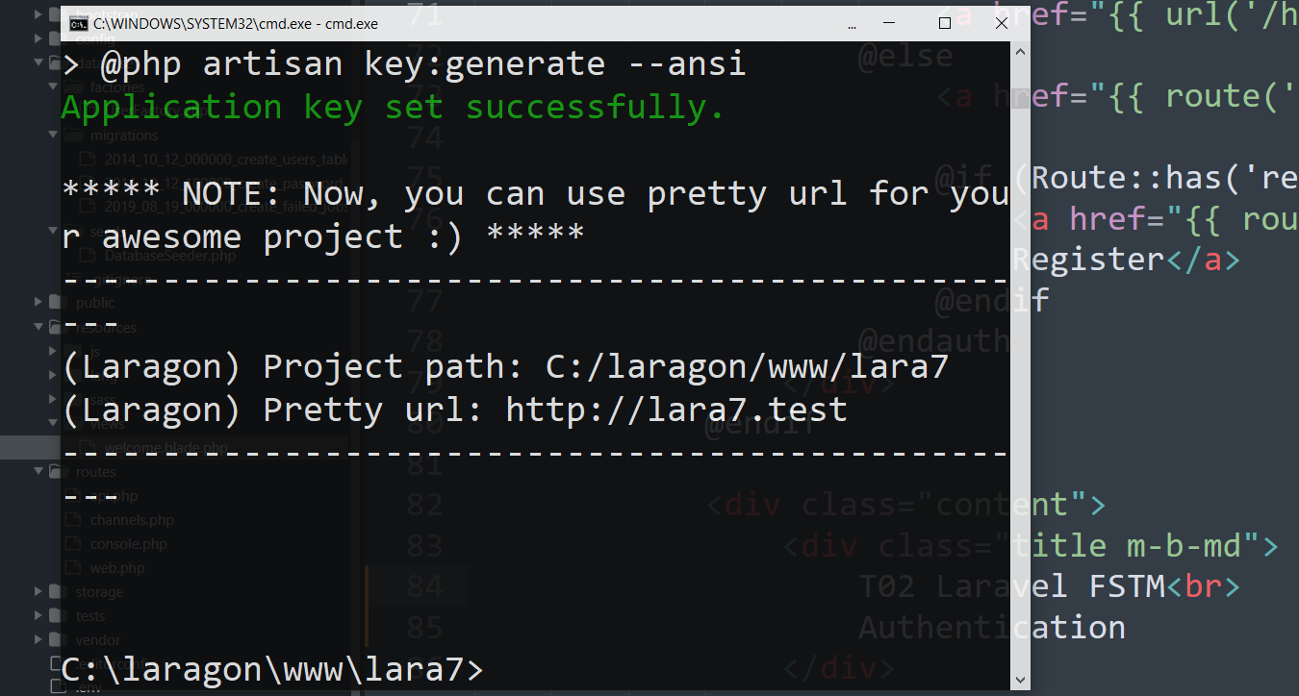
Laravel project with Pretty URL
Test the Pretty url in browser

Slide 14
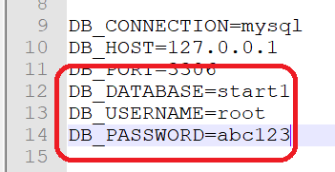
Update DB credentials in .env

Slide 15
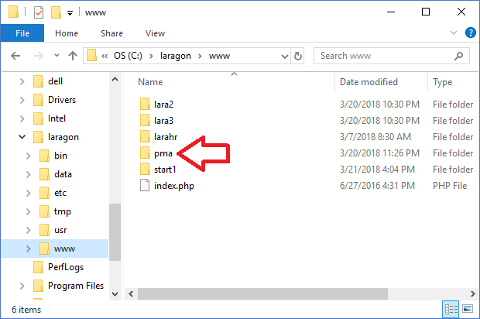
Download and install phpmyadmin.Net
Try access
http://localhost/pma

Slide 16
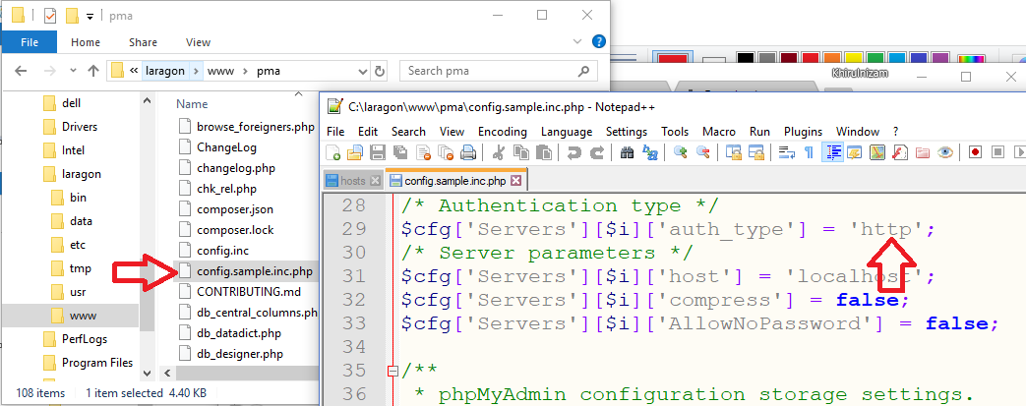
Phpmyadmin config.inc

Slide 17
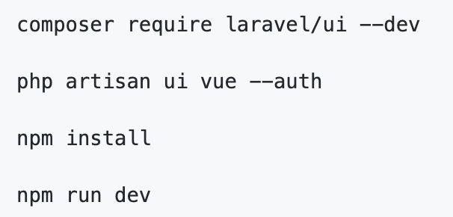
Authentication Module
Laravel makes implementing authentication very simple. In fact, almost everything is configured for you out of the box.

Slide 18
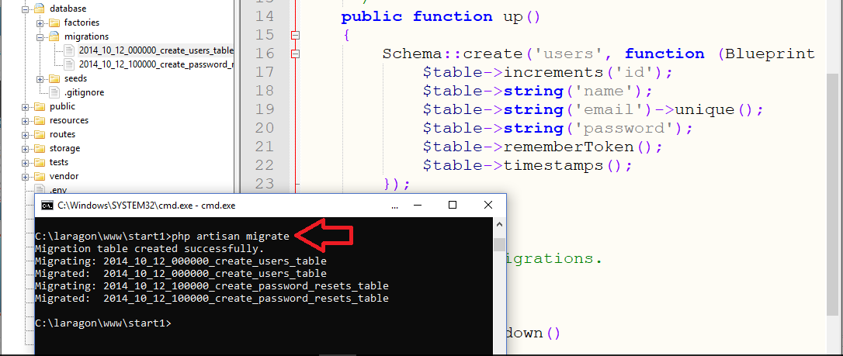
Authentication Module

Slide 19
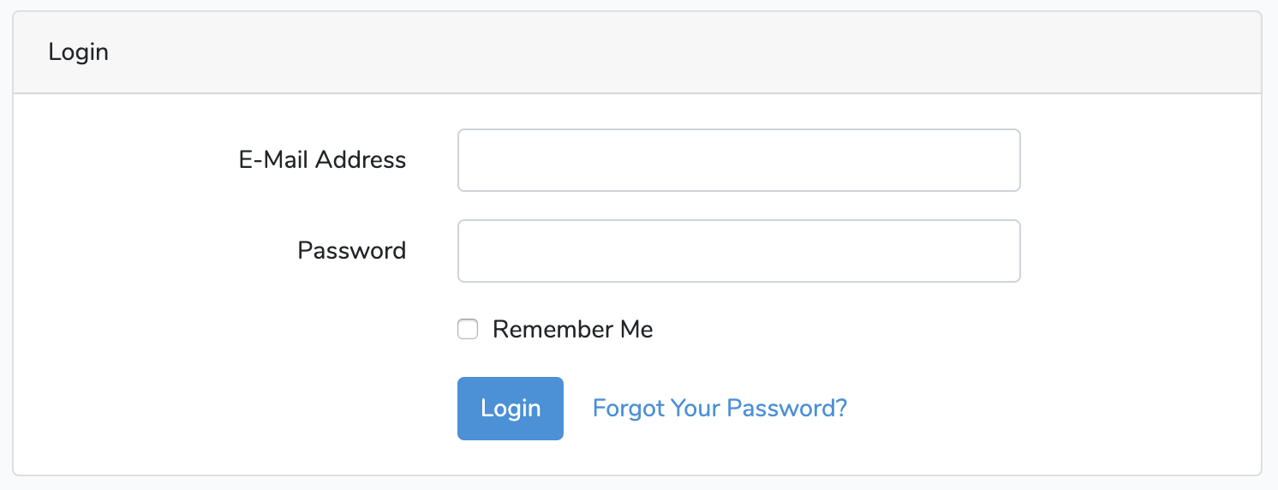
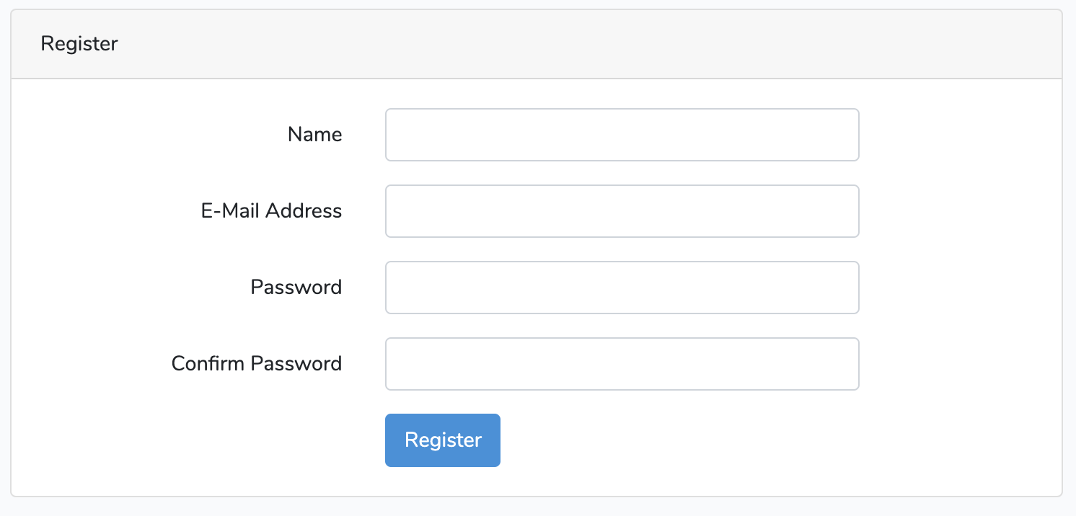
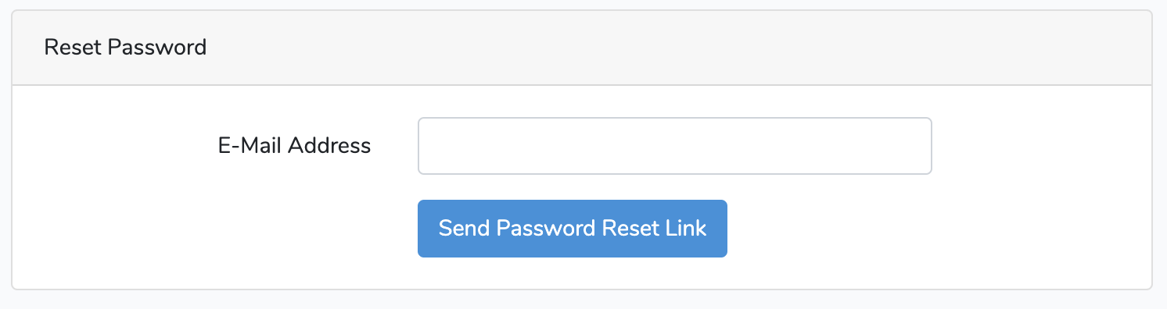

Slide 20
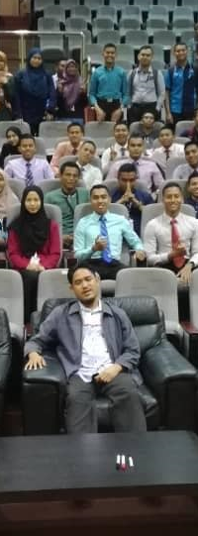
T03 Pangkalan data – migration, seeder & factory
bit.ly/laravelkerul

Slide 21
routes/web.php
app/Http/Controllers
app/
resources/views
Notes:
In Slide Show mode, select the arrows to visit links.

Slide 22
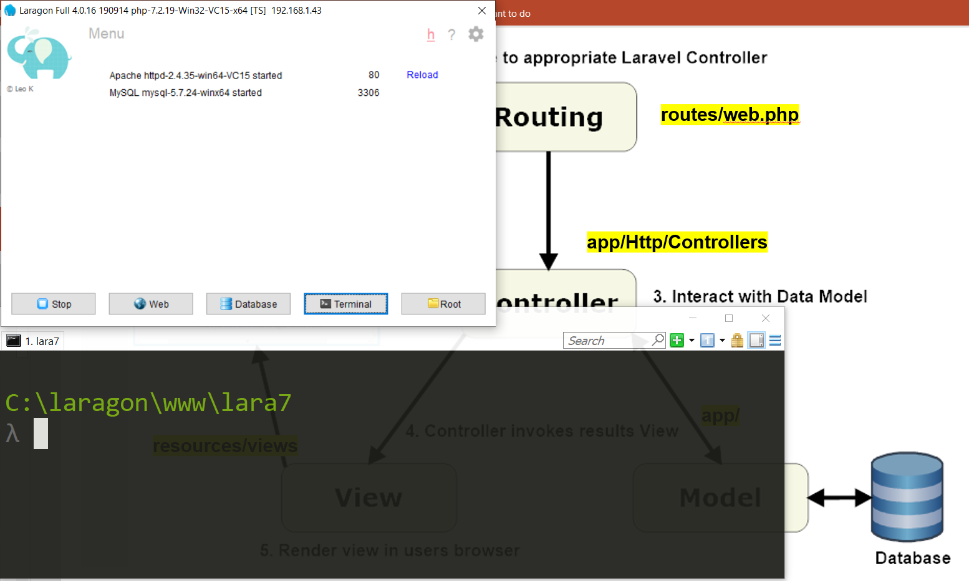

Slide 23
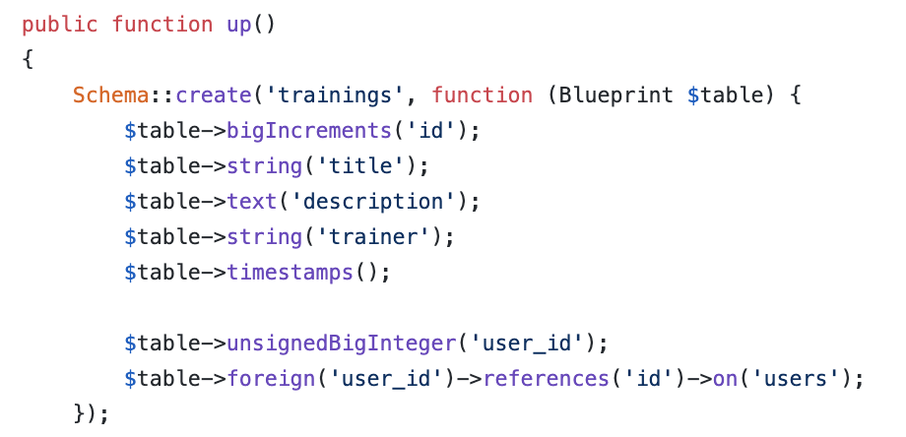
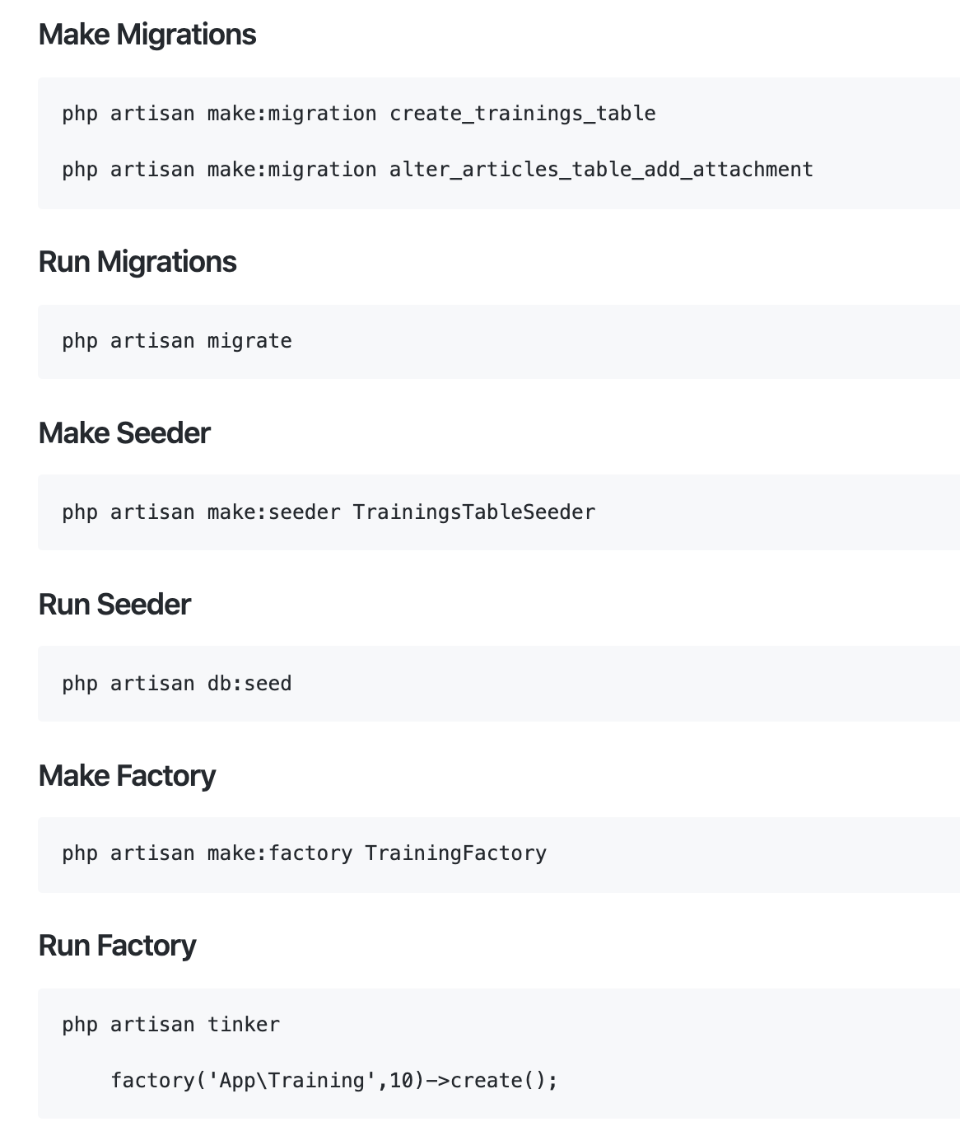
Working with Database
Database Migrations
Migrations are like version control for your database.

Slide 24
php artisan migrate

Slide 25
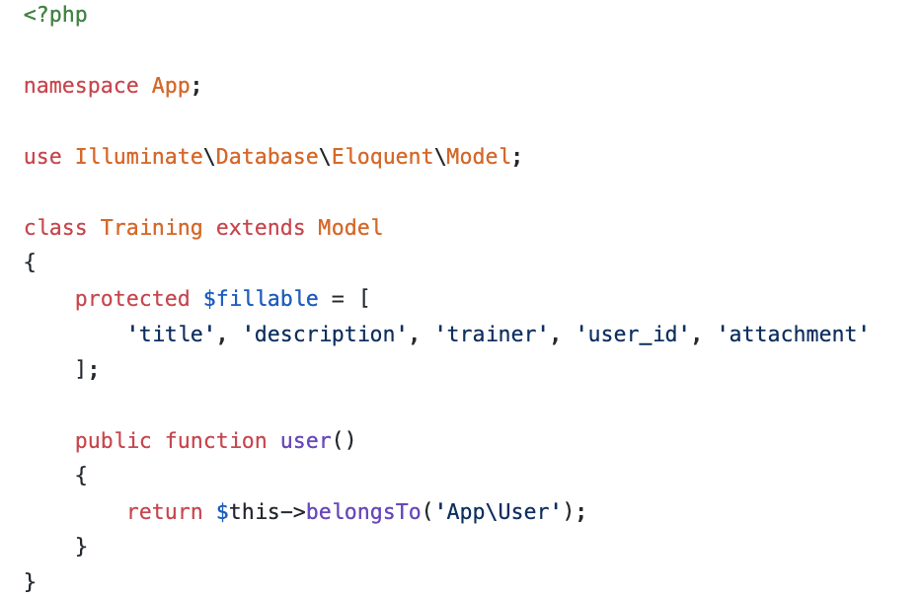
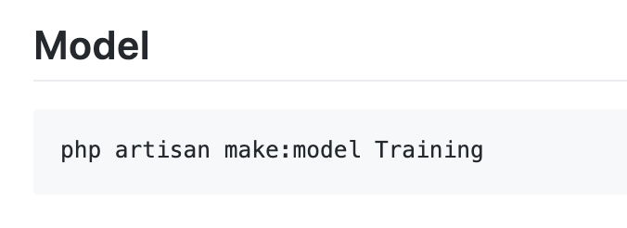
Model
Models typically live in the app directory.
All Eloquent models extend Illuminate\Database\Eloquent\Model class.

Slide 26
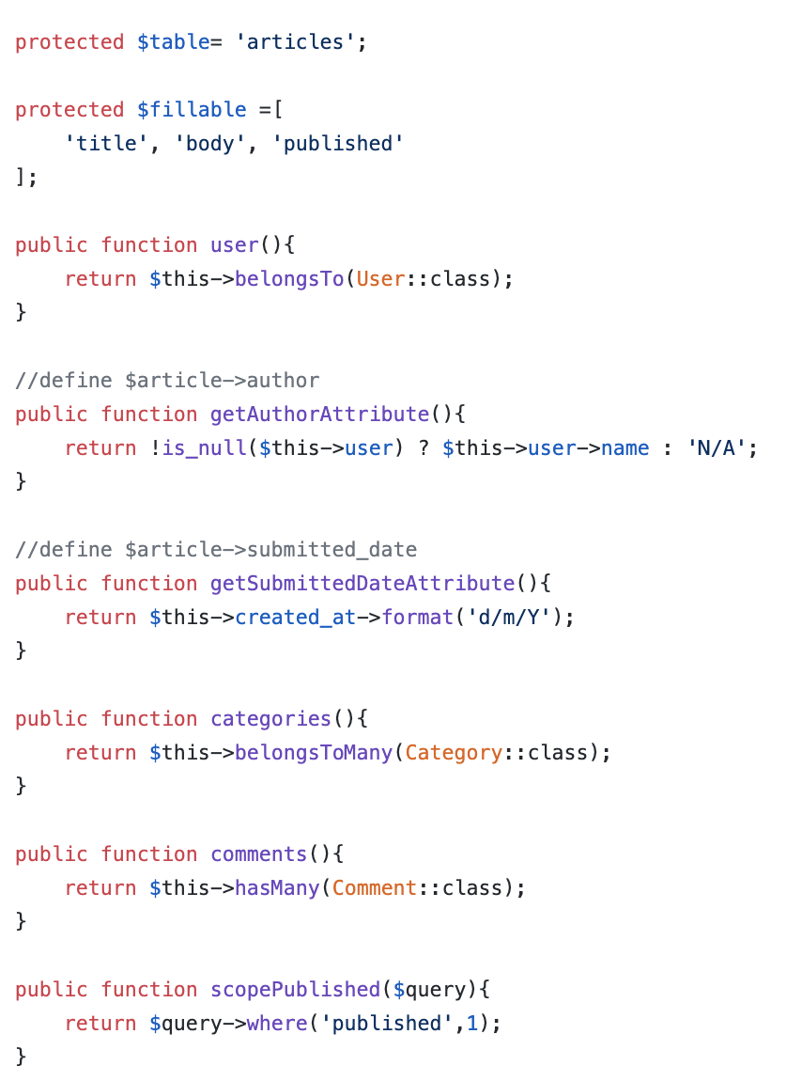
Model
Model used to define fillable attributes.
Model also can be used to define relationship
Model also can be used to to specify custom table.
Model also can be used to define mutator
Model also can be used to define local scope

Slide 27
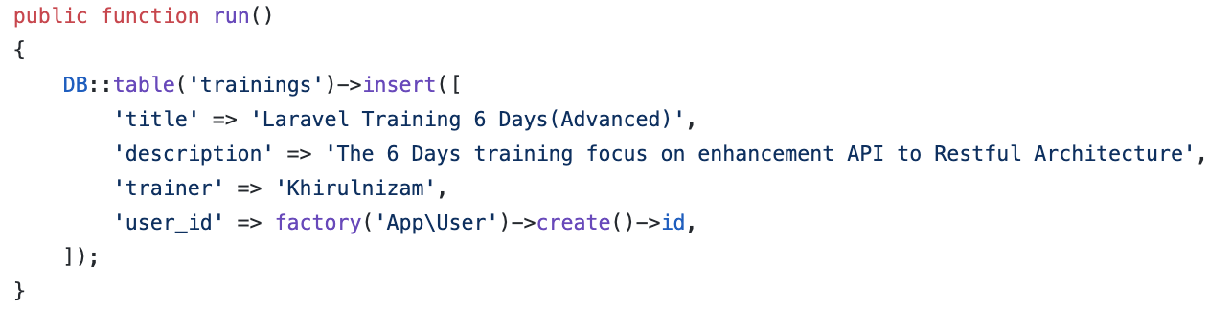
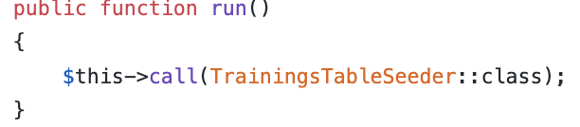
Working with Database
On database/seeds/TrainingsTableSeeder.php
Database Seeds
Laravel includes a simple method of seeding your database with test data using seed classes.
On database/seeds/DatabaseSeeder.php

Slide 28
Working with Database : run seeder

Slide 29
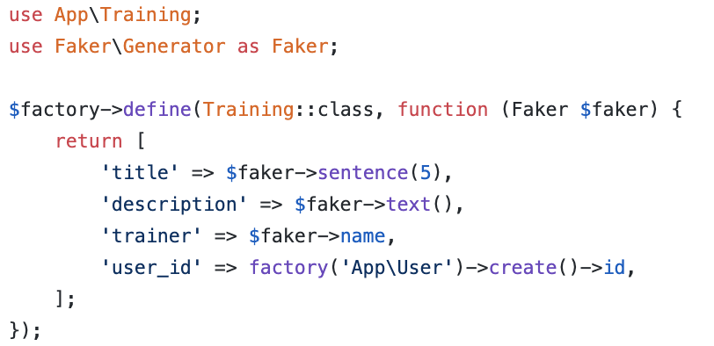
Working with Database
Database Factories
Laravel has a feature called model factories that allows you to build fake data for your models.

Slide 30
How to create and run migrations, seeder and factory?
Here are the example.

Slide 31
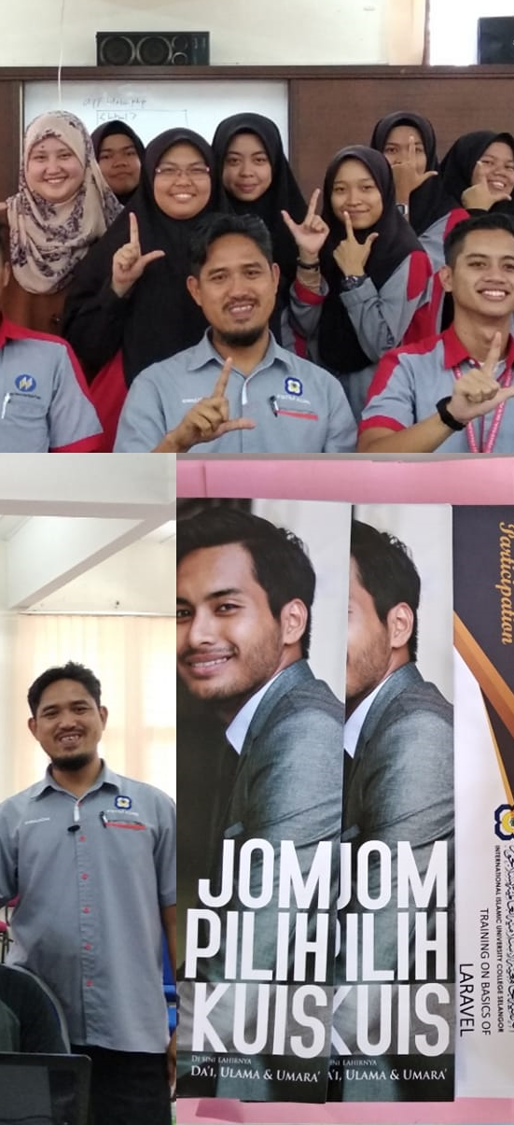
Laravel t04 Views (create form)
fstm.kuis.edu.my/blog/laravel

Slide 32
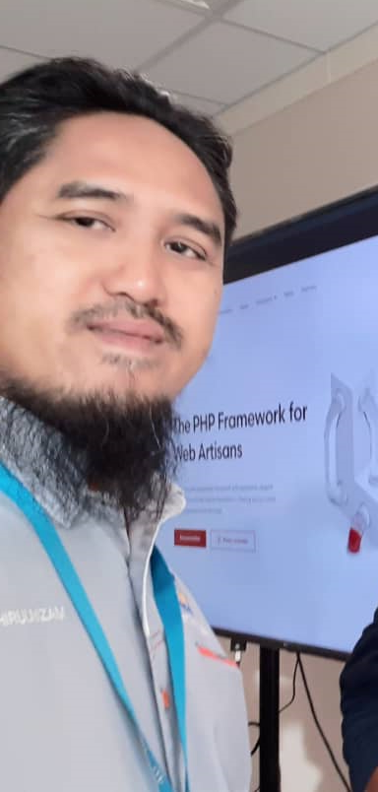
Laravel t05 Views (save new record)
fstm.kuis.edu.my/blog/laravel

Slide 33
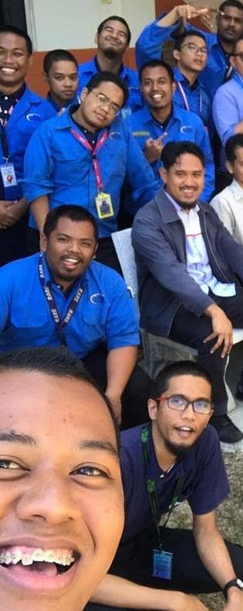
Laravel t06 Views (list records in index)
fstm.kuis.edu.my/blog/laravel

Slide 34
routes/web.php
app/Http/Controllers
app/
resources/views
Notes:
In Slide Show mode, select the arrows to visit links.

Slide 35
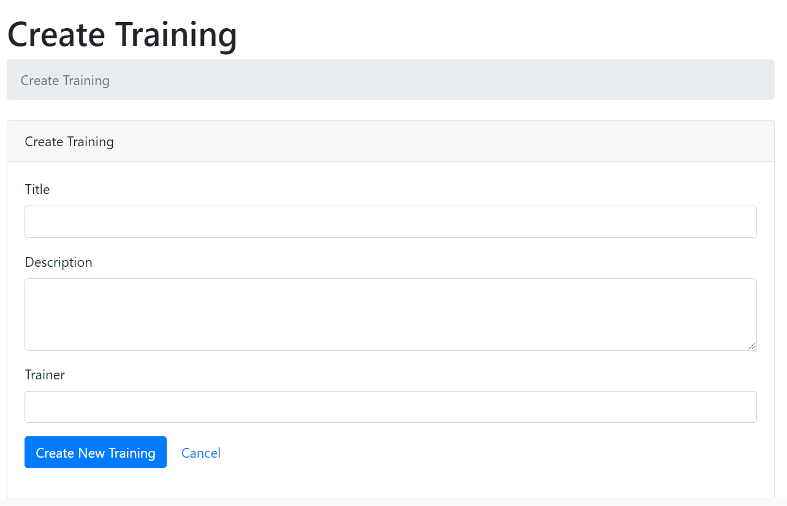
Create new record interface (create.blade.php)

Slide 36
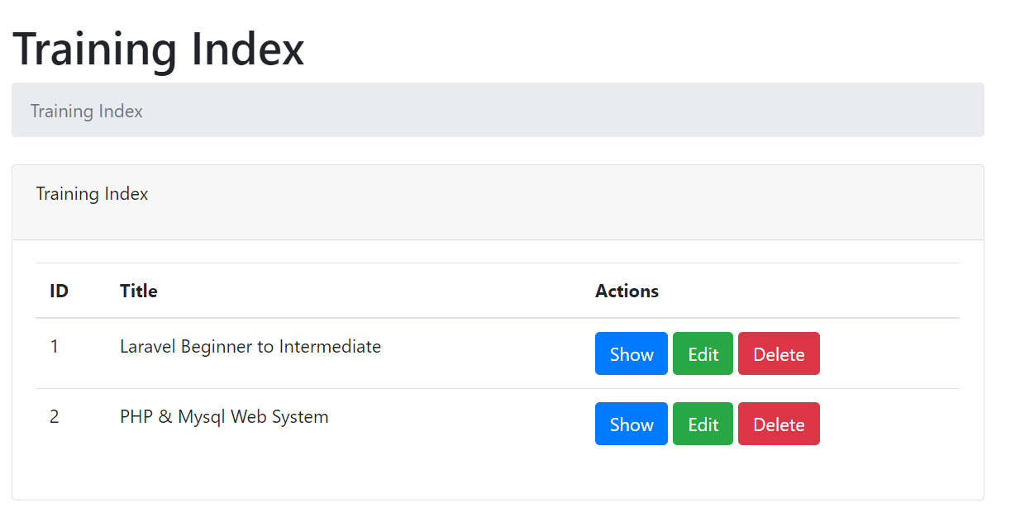
Training index.blade.php

Slide 37
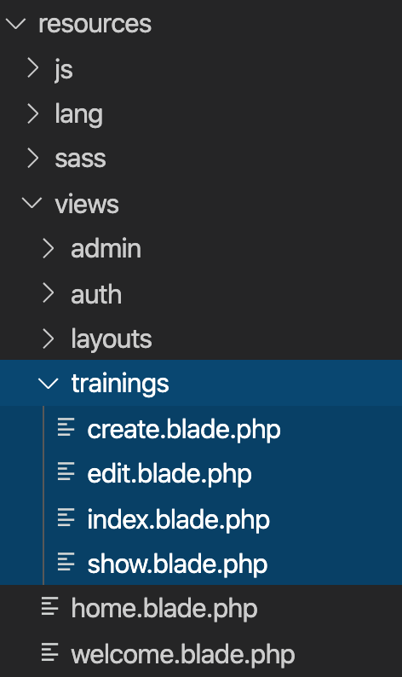
Views
Views contain the HTML served by your application and separate your controller / application logic from your presentation logic.
Views are stored in the resources/views directory
Go to resources/views
Create training folder
Inside training folder, create:
create.blade.php
index.blade.php

Slide 38
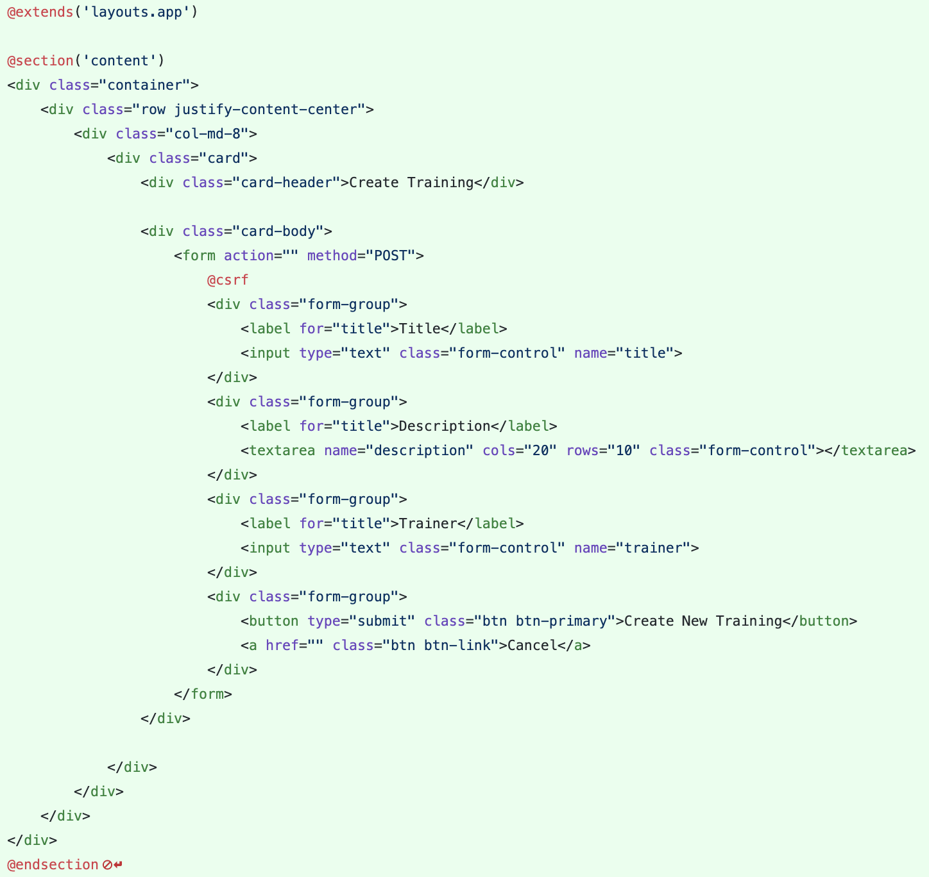
Views – Create View
Views are stored in the resources/views directory
Go to resources/views/trainings/create.blade.php

Slide 39
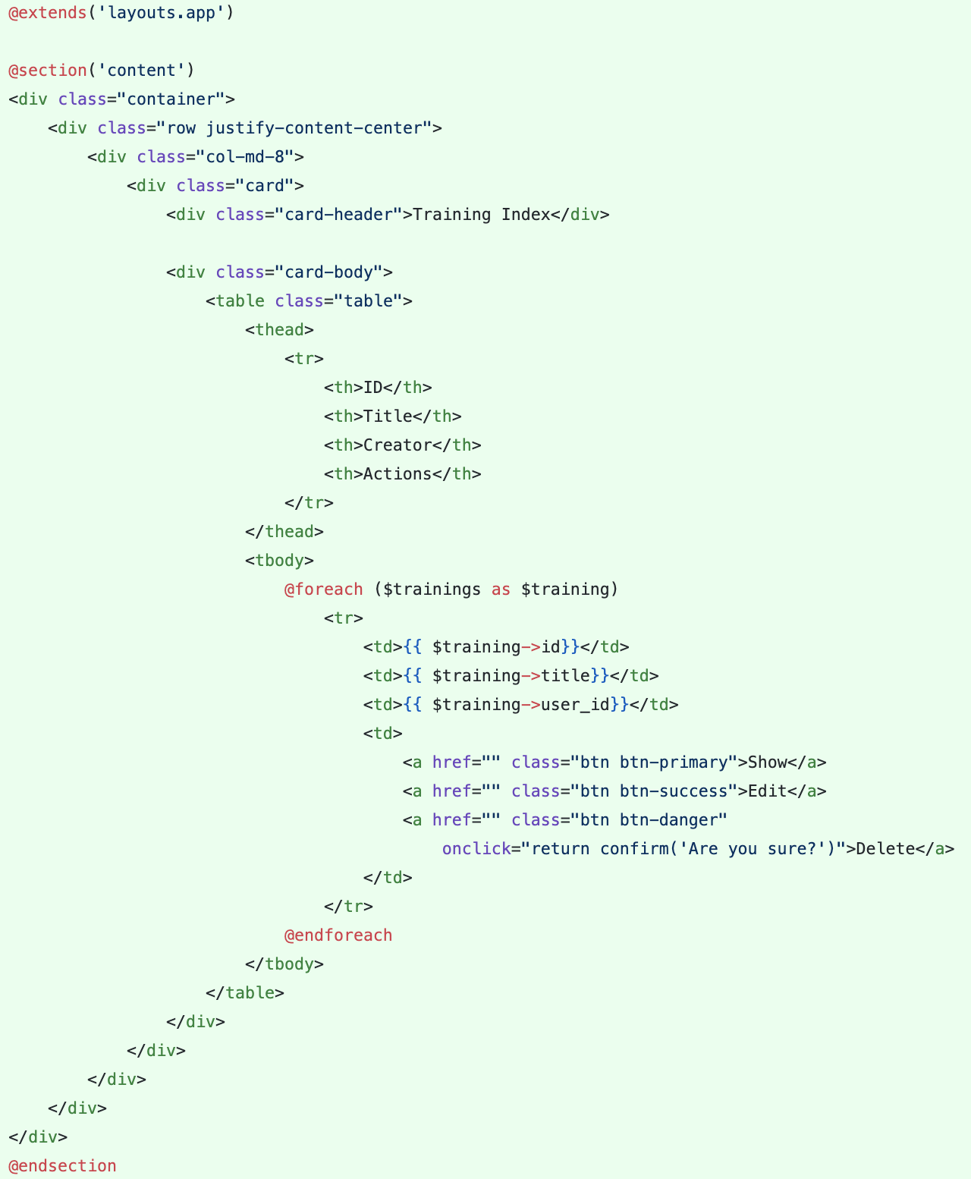
Views – Index View
Views are stored in the resources/views directory
Go to resources/views/trainings/index.blade.php

Slide 40
Laravel t07 Controller
http://fstm.kuis.edu.my/blog/laravel

Slide 41
routes/web.php
app/Http/Controllers
app/
resources/views
Notes:
In Slide Show mode, select the arrows to visit links.

Slide 42
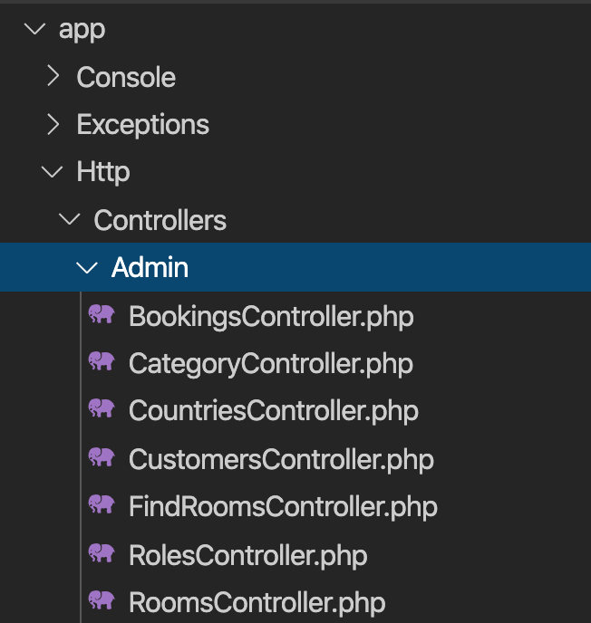
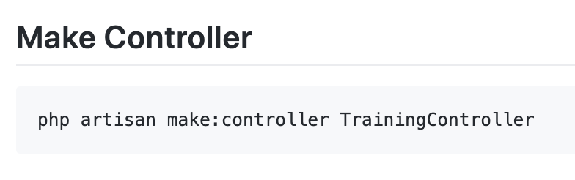
Controller
Instead of defining all of your request handling logic as Closures in route files, you may wish to organize this behavior using Controller classes.
Controllers can group related request handling logic into a single class.
Controllers are stored in the.app/Http/Controllers directory.

Slide 43
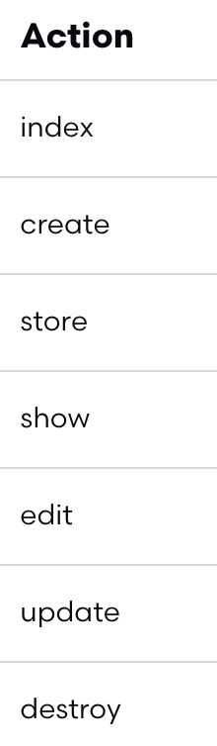
Controller
7 method in controllers

Slide 44
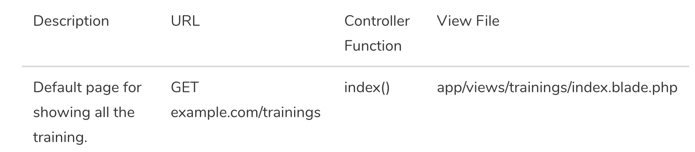
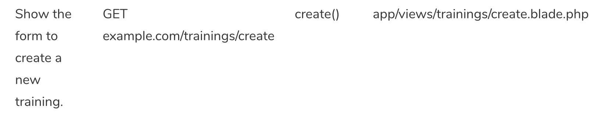
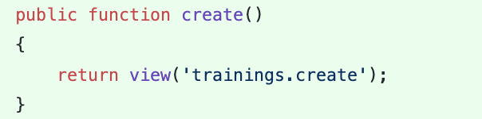
Controller - Create

Slide 45
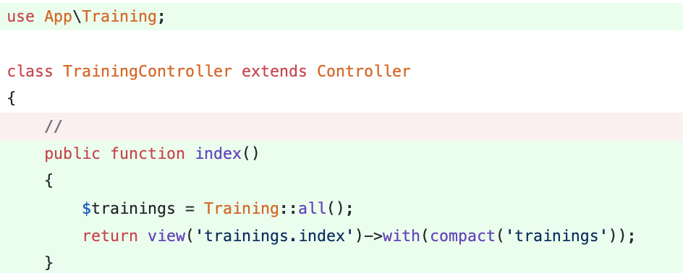
Controller - Index

Slide 46
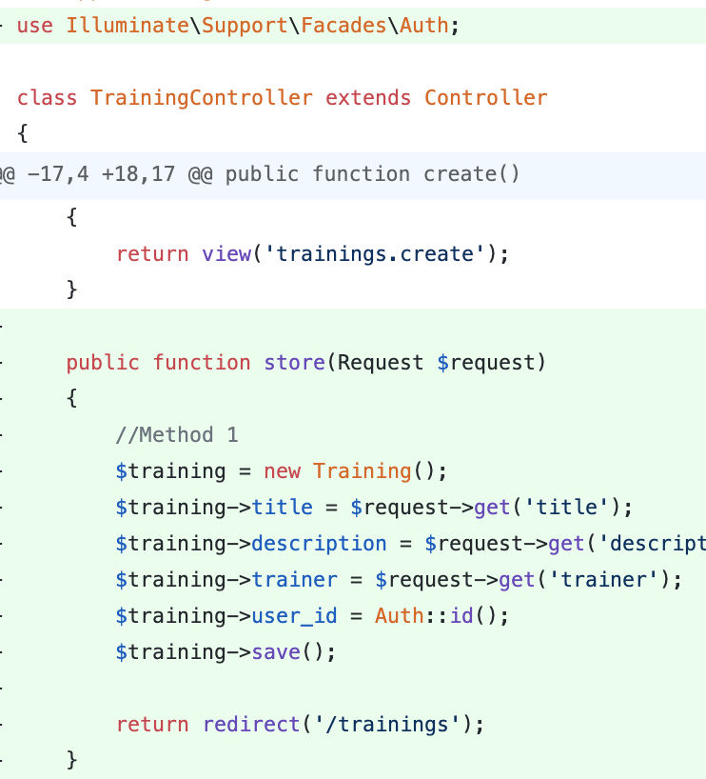
Controller - Store

Slide 47
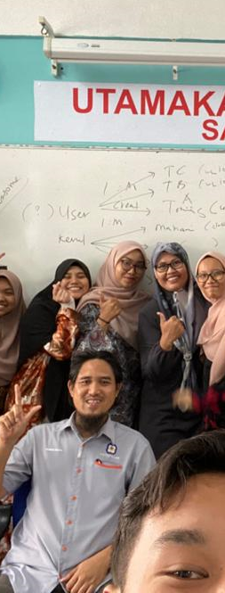
Laravel t09 Routing
Youtube : bit.ly/laravelkerul

Slide 48
routes/web.php
app/Http/Controllers
app/
resources/views
Notes:
In Slide Show mode, select the arrows to visit links.

Slide 49
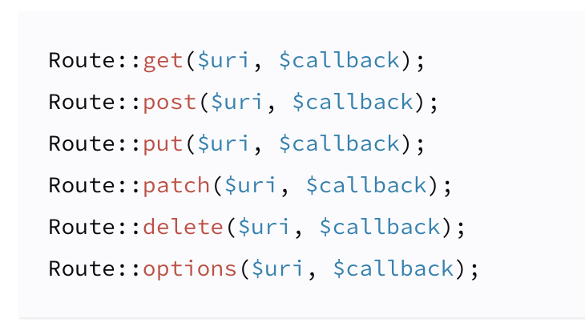
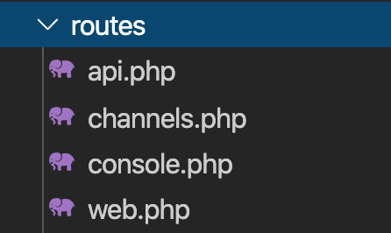
Routing
All Laravel routes are defined in your route files, which are located in the routes directory.
https://laravel.com/docs/6.x/routing.

Slide 50
Simple Routing
All Laravel routes are defined in your route files, which are located in the routes directory.
https://laravel.com/docs/6.x/routing.

Slide 51
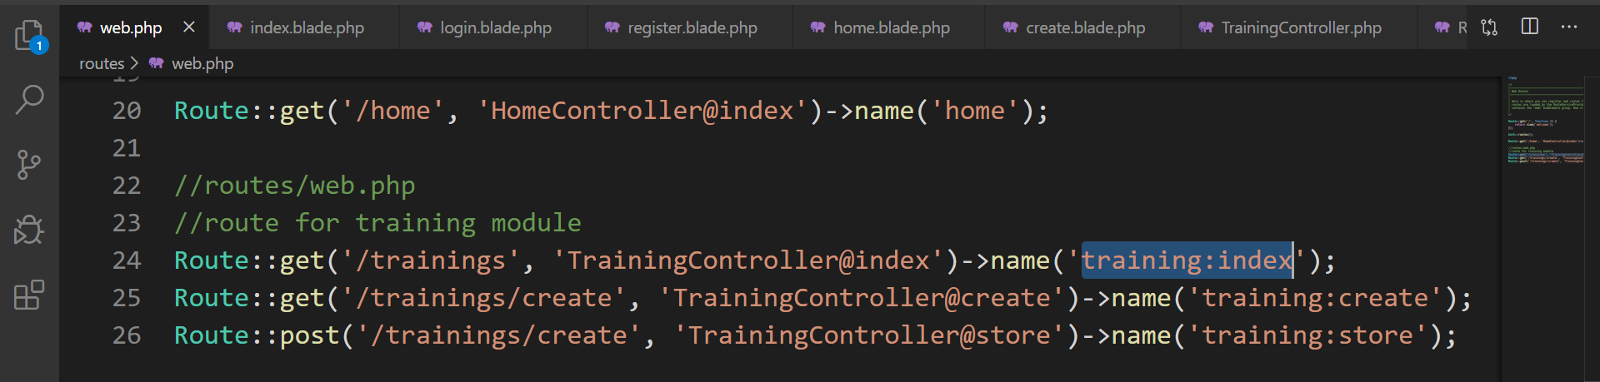
Simple routing ( routes/web.php )
index

Slide 52
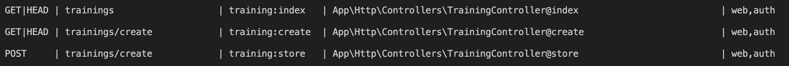
Simple Routing
php artisan route:list
https://laravel.com/docs/6.x/routing.

Slide 53
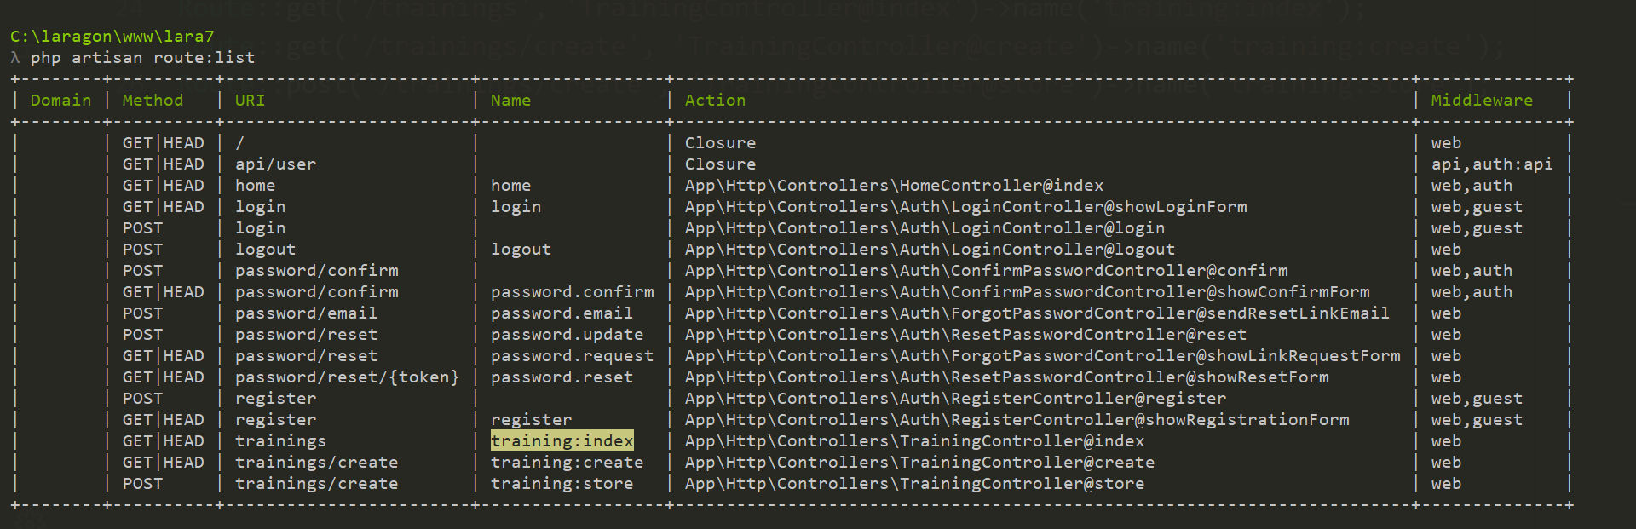
php artisan route:list

Slide 55
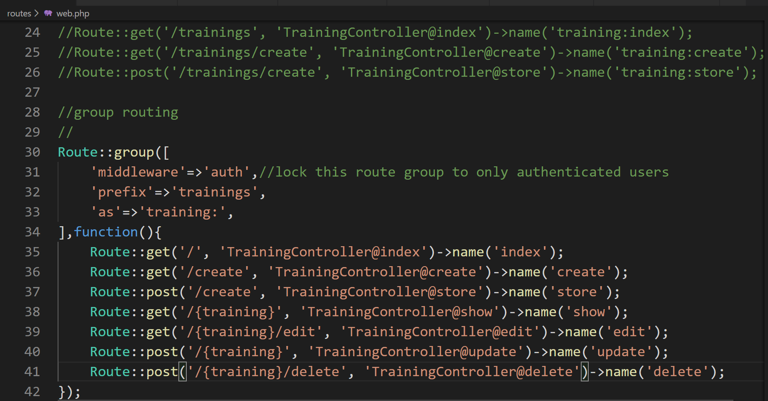
Advanced ROUTING: group & named

Slide 56
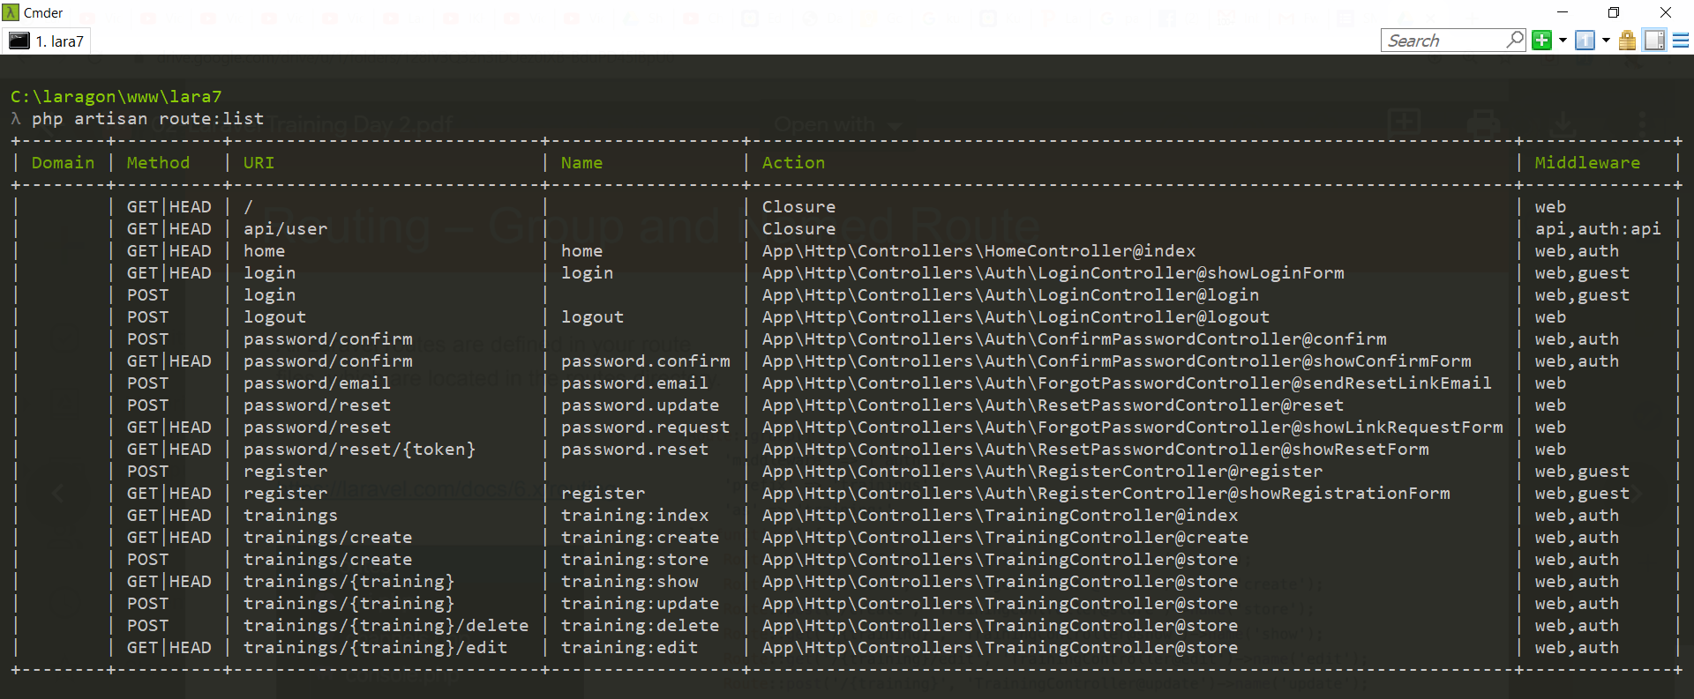
php artisan route:list

Slide 57
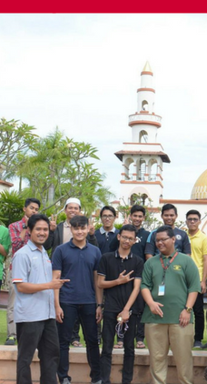
Laravel t07 Search
Tarmizi Sanusi
Khirulnizam Abd Rahman
fstm.kuis.edu.my/blog/laravel

Slide 58
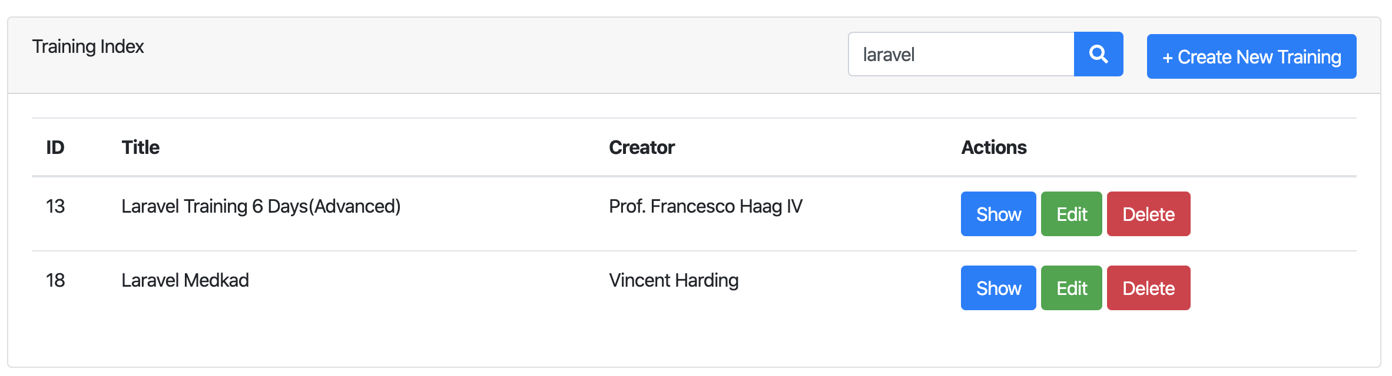
Search
Create form to input keyword
Query the keyword that match with title
https://github.com/samtarmizi/laravel-spr/commit/f5e85dcda0efc4e48186691e3f330f6278dcee52

Slide 59

Search - Form
Using GET method to named route training:index

Slide 60

Simple routing ( routes/web.php )
index

Slide 61
Simple Routing
php artisan route:list
https://laravel.com/docs/6.x/routing.

Slide 62

Search – Index Method
Check if there is keyword, if there is keyword on query string, run query to search column where like title.
If no keyword, the method will return collection rows from trainings table.

Slide 63

Laravel t08 Pagination
Tarmizi Sanusi
Khirulnizam Abd Rahman
fstm.kuis.edu.my/blog/laravel

Slide 64


Slide 65


Search - Pagination
The paginate method automatically takes care of setting the proper limit and offset based on the current page being viewed by the user and append with keywords.
https://github.com/samtarmizi/laravel-spr/commit/6b0d8b3c64bd42c58af97fc49b2c48d983273f1d

Slide 66

TrainingController@index

Slide 67
Hacks
Creating Index - https://github.com/samtarmizi/laravel-spr/commit/1c925853f61da081f0e3ce298e58a4a423b66040
Creating Create - https://github.com/samtarmizi/laravel-spr/commit/7a5b5f3b643bcb8a265af3bb9f4e94e3aef95aa1
Creating Store - https://github.com/samtarmizi/laravel-spr/commit/2513b55c65bc4d27afa5004144ee2c7d41b3cbd7

Slide 68
Laravel t10 npm not found
fstm.kuis.edu.my/blog/laravel

Slide 69


npm not found

Slide 70
Authentication Module
Laravel makes implementing authentication very simple. In fact, almost everything is configured for you out of the box.

Slide 71

Laragon
Includes NODEJS

Slide 72

Terminal in Laragon
Laravel makes implementing authentication very simple. In fact, almost everything is configured for you out of the box.

Slide 73

Locate nodejs in Laragon

Slide 74

Environment variables

Slide 75

Set path to nodejs

Slide 76

NODEJS.ORG

Slide 77

Laravel t11 Middleware enforced Auth
fstm.kuis.edu.my/blog/laravel

Slide 78

Middleware
Middleware provide a convenient mechanism for filtering HTTP requests entering your application.
For example, Laravel includes a middleware that verifies the user of your application is authenticated. If the user is not authenticated, the middleware will redirect the user to the login screen.

Slide 79

Add to dashboard menu

Slide 80

Laravel t12 Test Laravel project from Github repo

Slide 81
NODEJS.ORG

Slide 82

Github.com/khirulnizam/lara7

Slide 83

Git clone

Slide 84

composer & npm install

Slide 85

.env file

Slide 86
php artisan migrate & seed
Inside Laravel project folder
php artisan key:generate
php artisan migrate
php artisan db:seed

Slide 87
Laravel t13 Show records (Paparan semua data dalam rekod)

Slide 88

Table with lots of column

Slide 89
Github.com/khirulnizam/lara7
Slides & codes

Slide 90
DISCLAIMER
Codes are for demo purposes. Example showed here are only to validate the proof of concepts. Security aspect the demonstrated examples are beyond the coverage of these video tutorials. You are advised to explore / sought after advanced/security topics of PHP web programming as these tutorials only for beginner level.
Suitable to view in DESKTOP

Slide 91
Views
Views are stored in the resources/views directory
Go to resources/views
Go to trainings folder, create:
show.blade.php
edit.blade.php

Slide 92
Controller
7 method in controllers

Slide 93
routes/web.php
app/Http/Controllers
app/
resources/views
Notes:
In Slide Show mode, select the arrows to visit links.

Slide 94


Controller - Show

Slide 95
Views – Show View
Views are stored in the resources/views directory
Go to resources/views/trainings/show.blade.php

Slide 96

Github.com/khirulnizam/lara7

Slide 97
Github.com/khirulnizam/lara7
Slides & codes

Slide 98


Laravel t14 Font-awesome thru CDN (Pasang icon font-awesome guna CDN)

Slide 99
Github.com/khirulnizam/lara7
Slides & codes

Slide 100

CDN – CONTENT DELIVERY NETWORK
CDN – load library/ framework from public host server
to provide high availability and performance
https://www.bootstrapcdn.com/fontawesome/

Slide 101

FONTAWESOME IN SIMPLE HTML

Slide 102

Import font-awesome from CDN

Slide 103

Tag: <i></i>
<i class="fa fa-file-text"></i>
<p>Used on a button:</p>
<button>
Show <i class="fa fa-file-text"></i>
</button>

Slide 104

Import font-awesome CDN in Laravel layout

Slide 105
https://www.bootstrapcdn.com/fontawesome/

Slide 106

Implement in buttons

Slide 107
Github.com/khirulnizam/lara7
Slides & codes

Slide 108
Laravel t15 Edit/Update (Kemaskini data dalam rekod)

Slide 109

UPDATE RECORD PROCESS
Index (choose )
id
Edit (form)
id
Update (save)

Slide 110
DISCLAIMER
Codes are for demo purposes. Example showed here are only to validate the proof of concepts. Security aspect the demonstrated examples are beyond the coverage of these video tutorials. You are advised to explore / sought after advanced/security topics of PHP web programming as these tutorials only for beginner level.
Suitable to view in DESKTOP

Slide 111
Github.com/khirulnizam/lara7
Slides & codes
T12 Tutorial clone/download github repo

Slide 112


Controller - Edit

Slide 113
Views – Edit View
Views are stored in the resources/views directory
Go to
resources/views/trainings/edit.blade.php

Slide 114


Slide 115


Controller - Update

Slide 116


Output screen

Slide 117
Laravel t16 Delete records (Padam rekod)

Slide 118
DISCLAIMER
Codes are for demo purposes. Example showed here are only to validate the proof of concepts. Security aspect the demonstrated examples are beyond the coverage of these video tutorials. You are advised to explore / sought after advanced/security topics of PHP web programming as these tutorials only for beginner level.
Suitable to view in DESKTOP

Slide 119
Github.com/khirulnizam/lara7
Slides & codes
T12 Tutorial clone/download github repo

Slide 120

Overview

Slide 121

Delete button inside FORM

Slide 122

Routing – Group and Named Route
All Laravel routes are defined in your route files, which are located in the routes directory.
https://laravel.com/docs/7.x/routing.

Slide 123

Routing – Group and Named Route
php artisan route:list
https://laravel.com/docs/7.x/routing.

Slide 124


Controller – Destroy/Delete

Slide 125
Laravel t17 @csrf (Built-in security token for post method) bit.ly/fstmtubelaravel

Slide 126
DISCLAIMER
Codes are for demo purposes. Example showed here are only to validate the proof of concepts. Security aspect the demonstrated examples are beyond the coverage of these video tutorials. You are advised to explore / sought after advanced/security topics of PHP web programming as these tutorials only for beginner level.
Suitable to view in DESKTOP

Slide 127
Github.com/khirulnizam/lara7
Slides & codes
T12 Tutorial clone/download github repo

Slide 128

What is CSRF?
OWASP.org
Cross-Site Request Forgery
- is an attack that forces an end user to execute unwanted actions on a web application in which they're currently authenticated.

Slide 129


Implementation in Laravel blade

Slide 130



Location of csrf app_key
Use to hash security token

Slide 131
Laravel t18 Apply Bootstrap Layout (Pasang layout Bootstrap baru)

Slide 132

Output overview

Slide 133
DISCLAIMER
Codes are for demo purposes. Example showed here are only to validate the proof of concepts. Security aspect the demonstrated examples are beyond the coverage of these video tutorials. You are advised to explore / sought after advanced/security topics of PHP web programming as these tutorials only for beginner level.
Suitable to view in DESKTOP

Slide 134
Github.com/khirulnizam/lara7
Slides & codes
T12 Tutorial clone/download github repo

Slide 135

Theme from https://startbootstrap.com/themes/landing-page/

Slide 136

Asset/resources for template

Slide 137

Blade asset( ) function – apply on both css & js

Slide 138

@yield( )

Slide 139


@yield( )

Slide 140
Output overview

Slide 141

landingpage.blade.php

Slide 142

route/web.php

Slide 143
Github.com/khirulnizam/lara7
Slides & codes
T12 Tutorial clone/download github repo

Slide 144
Laravel t19 Apply Bootstrap on Admin Dashboard (Pasang layout Bootstrap baru pada Panel Admin)

Slide 145

Output overview

Slide 146
DISCLAIMER
Codes are for demo purposes. Example showed here are only to validate the proof of concepts. Security aspect the demonstrated examples are beyond the coverage of these video tutorials. You are advised to explore / sought after advanced/security topics of PHP web programming as these tutorials only for beginner level.
Suitable to view in DESKTOP

Slide 147
Github.com/khirulnizam/lara7
Slides & codes
T12 Tutorial clone/download github repo

Slide 148

Theme from https://startbootstrap.com/themes/sb-admin-2/

Slide 149

Asset/resources for template

Slide 150

First time display the new template

Slide 151

Blade asset( ) function – apply on both css & js

Slide 152

@yield( )

Slide 153


@yield( )
@yield( )

Slide 154
Output overview

Slide 155

index.blade.php

Slide 156
Github.com/khirulnizam/lara7
Slides & codes
T12 Tutorial clone/download github repo

Slide 157
Laravel t20
Muat naik fail gambar

Slide 158


Upload image
Show uploaded image
Upload image

Slide 159
DISCLAIMER
Codes are for demo purposes. Example showed here are only to validate the proof of concepts. Security aspect the demonstrated examples are beyond the coverage of these video tutorials. You are advised to explore / sought after advanced/security topics of PHP web programming as these tutorials only for beginner level.
Suitable to view in DESKTOP

Slide 160
Github.com/khirulnizam/lara7
Slides & codes
T12 Tutorial clone/download github repo

Slide 161

Add column to table trainings
Field to hold image’s filename

Slide 162

Additional field to table trainings

Slide 163

function up() – additional migration file

Slide 164

php artisan migrate

Slide 165

create.blade.php – to select and upload image
Upload image

Slide 166

Add enctype in create.blade.php

Slide 167

Add input type=“file” in create.blade.php

Slide 168

app/Training.php - Add fillable for the fields

Slide 169

Validate uploaded file type

Slide 170

TrainingController@store – validate file type

Slide 171

TrainingController@store – continued…

Slide 172


Storage not found

Slide 173

Configuring Filesystem for Storage config/filesystems.php

Slide 174

File Storage
Create Symbolic Link
The public disk is intended for files that are going to be publicly accessible.
By default, the public disk uses the local driver and stores these files in storage/app/public.
To make them accessible from the web, you should create a symbolic link from public/storage to storage/app/public.

Slide 175

Virtual link of public file storage

Slide 176

Physical link of public file storage
The actual physical location of the file storage
To make them accessible from the web, you should create a symbolic link from public/storage to storage/app/public.

Slide 177

create.blade.php - Display validation errors

Slide 178
Github.com/khirulnizam/lara7
Slides & codes
T12 Tutorial clone/download github repo

Slide 179
Laravel t21 Table relationship (Jadual dengan perhubungan 1-Many)

Slide 180
Laravel t22 Insert record with drop down data option (Masukkan data baharu dengan jadual berhubungan)

Slide 181
Laravel t23 Upload record with file (Muat naik sebarang fail)

